Slide 1
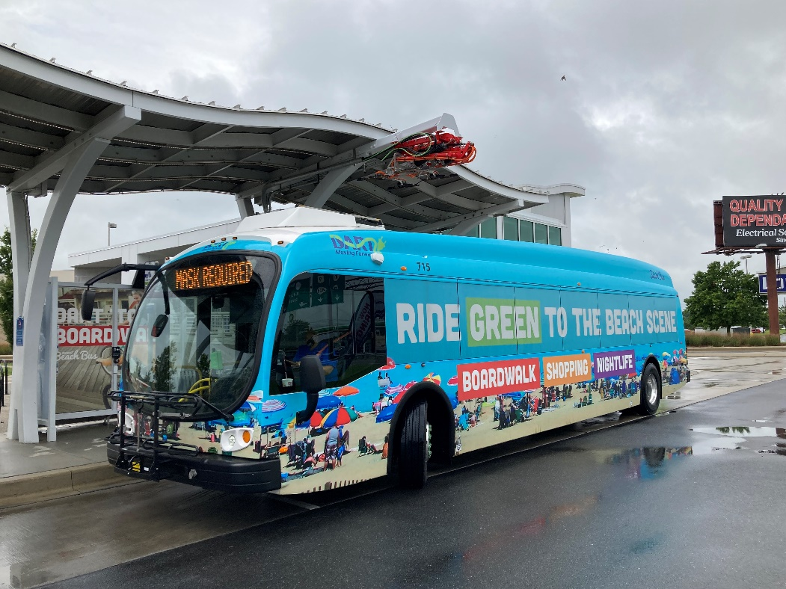
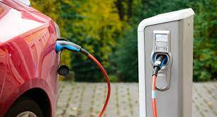
National Electric Vehicle Infrastructure (NEVI) Program
2022 Utility Workshop
Jim Pappas, P.E.
Director - Transportation Resiliency & Sustainability

Slide 2
National Electric Vehicle Infrastructure (NEVI) Program
From Bipartisan Infrastructure Law (BIL) and enacted as the Infrastructure Investment and Jobs Act (IIJA).
Goal of 500,000 EV chargers nationally by 2030.
Each state required to submit EV Infrastructure Deployment Plan to newly created Joint Office of Energy and Transportation by August 1, 2022.
Plan must describe how states will use apportioned funds.
Delaware to receive over $2.6M in FY 22 for this program.

Slide 3
National Electric Vehicle Infrastructure (NEVI) Program
Goal of 500,000 national network of EV chargers:
Accelerate equitable adoption of EV’s, including for those who cannot reliably charge at home.
Reduce transportation-related greenhouse gas emissions and help put the US on a path to net-zero emissions by no later than 2050.
Position US industries to lead global transportation electrification effort.
BIL includes a total of $7.5B in dedicated funding for EV chargers; $5M in formula funding + $2.5B for discretionary grants.

Slide 4
National Electric Vehicle Infrastructure (NEVI) Program
$2.5B in discretionary grant funding used to ensure priorities of charging in rural areas, building resilient infrastructure, addressing climate change, and increased EV charging in underserved and overburdened communities.
Corridor Charging Grant Program – strategically deploy publicly accessible EV charging and hydrogen, propane, and natural gas fueling infrastructure along Alternative Fuel Corridors. (More details forthcoming)
Community Charging Grant Program – strategically deploy publicly accessible EV charging and hydrogen, propane, and natural gas fueling infrastructure in communities. (More details forthcoming)

Slide 5
National Electric Vehicle Infrastructure (NEVI) Program
NEVI will establish interconnected network to facilitate data collection, access, and reliability of EV charging infrastructure.
Initially, funding is directed to designated Alternative Fuel Corridors, particularly along the interstate.
After national network is built out, funding may be used on any public road or in publicly accessible locations which include transportation centers, Park-and-Rides, public schools, public parks, etc.

Slide 6
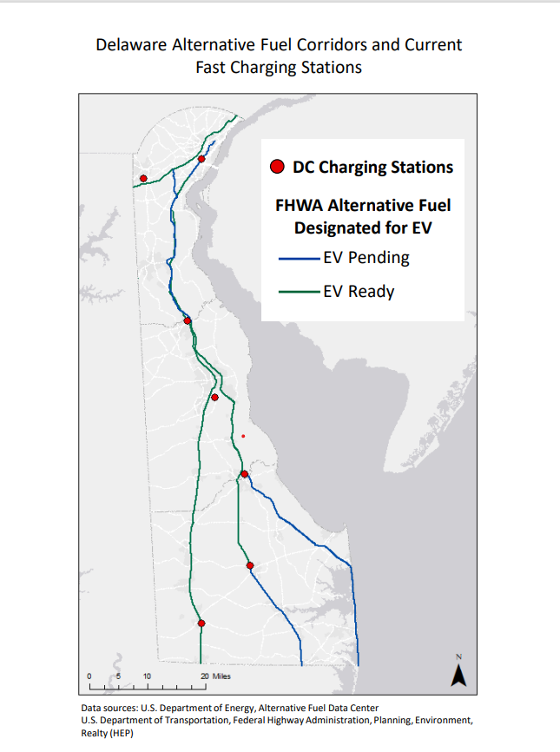
National Electric Vehicle Infrastructure (NEVI) Program
Alternative Fuel Corridors
EV charging infrastructure installed every 50 miles along interstate and within 1 mile of interstate ramps.
EV charging infrastructure includes at least four 150 kW Direct Current (DC) Fast Chargers with Combined Charging System (CCS) ports capable of simultaneously DC charging four EV’s.
EV charging infrastructure has minimum station power capacity at or above 600 kW and supports at least 150 kW per port simultaneously across four ports for charging.

Slide 7
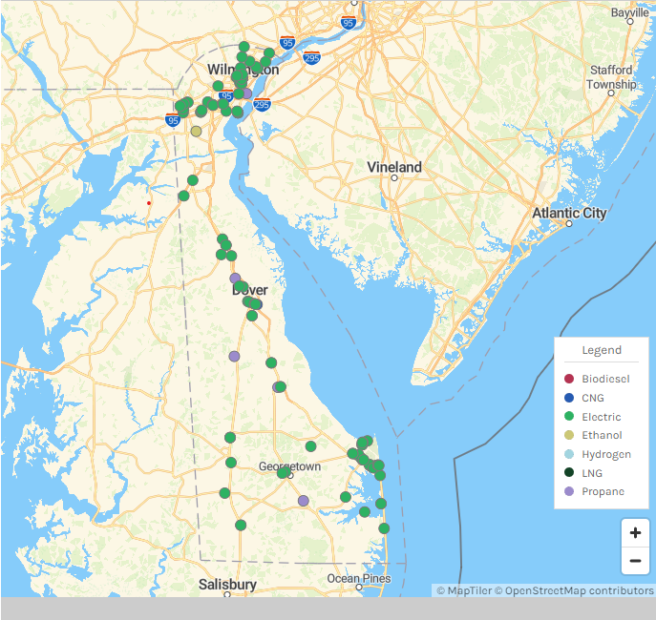
National Electric Vehicle Infrastructure (NEVI) Program
EV Charging Infrastructure Deployment Plan
Locate existing EV infrastructure with planned upgrades/expansions.
Include planned new EV infrastructure sites under NEVI.
Analysis on anticipated usage rates and peak demand.
Consider electric service readiness and future public transportation electrification needs.

Slide 8
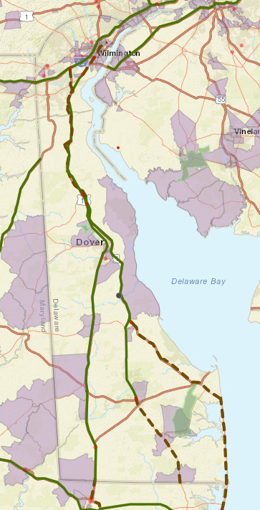
National Electric Vehicle Infrastructure (NEVI) Program
Equity considerations
Improve clean transportation.
Decrease transportation energy cost burden.
Reduce environmental exposure to transportation emissions.
Increase energy resilience.
Increase equitable access to electric grid.

Slide 9
National Electric Vehicle Infrastructure (NEVI) Program
Considerations for strategic deployment of EV infrastructure:
Charging infrastructure provides power regardless of time of day or time of year.
Minimize demand charges or other fixed utility fees.
Inclusion of distributed renewable energy resources (solar arrays, energy storage).
Use of station-level load management or smart charge management that encourages grid stability and reduce cost to station users.
Futureproofing plan for expansion as needed.

Slide 10
National Electric Vehicle Infrastructure (NEVI) Program
Considerations for strategic deployment of EV infrastructure (cont.)
Work with local utility operators to streamline planning and approval of grid connections.
Charging stations should be designed to provide at least four Combined Charging System (CCS) ports with power capabilities of no less than 600 kW.
Maximum charge power per DC port should not be below 150 kW and should consider design and construction practices that allow for 350 kW or greater for future upgrades.

Slide 11
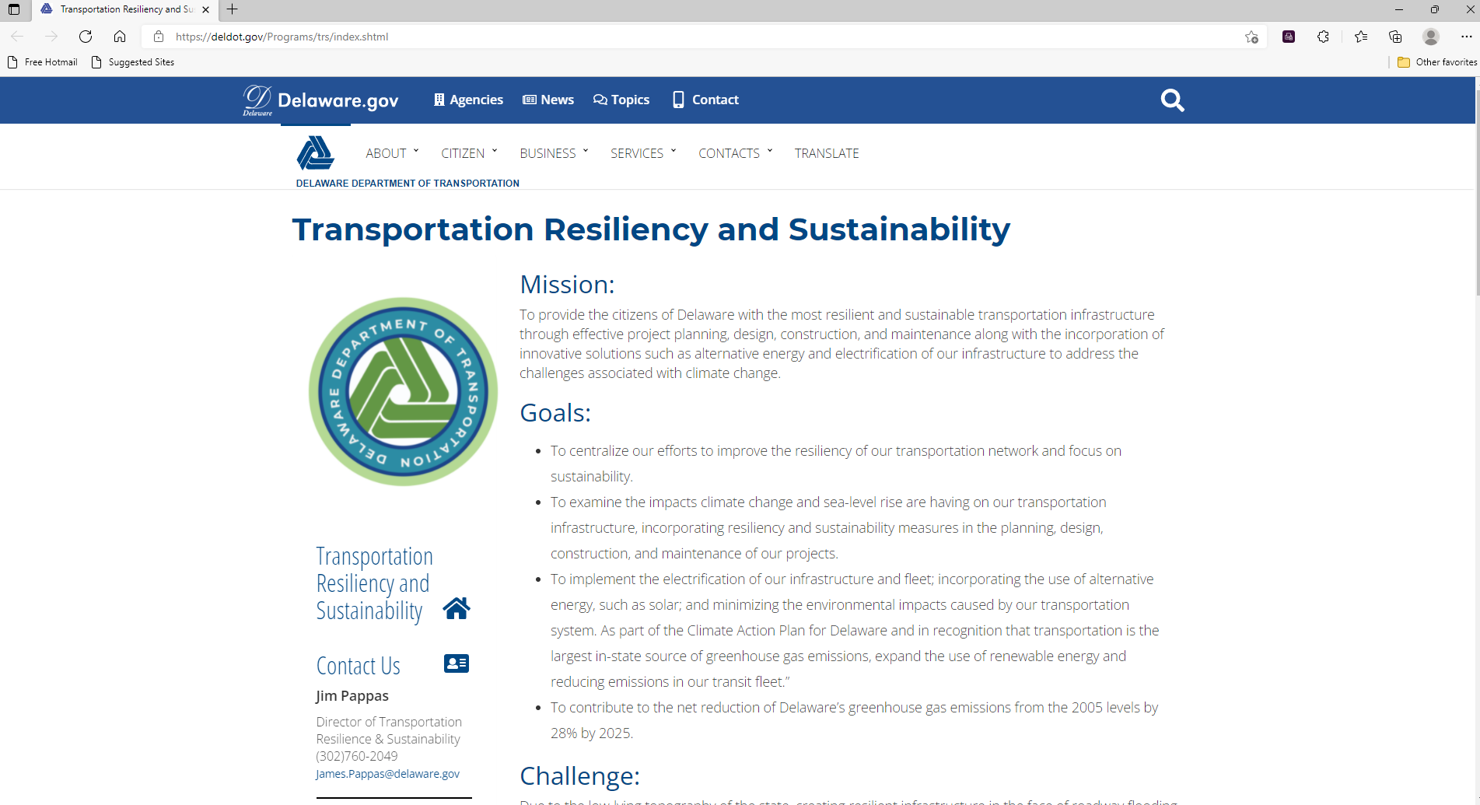

Slide 13
Thank you for your time and attention
Jim Pappas
james.pappas@delaware.gov

